Slide 1
DOELAP Assessor Training
Assessment Preparation
Idaho Falls, ID
September 2023

Slide 2
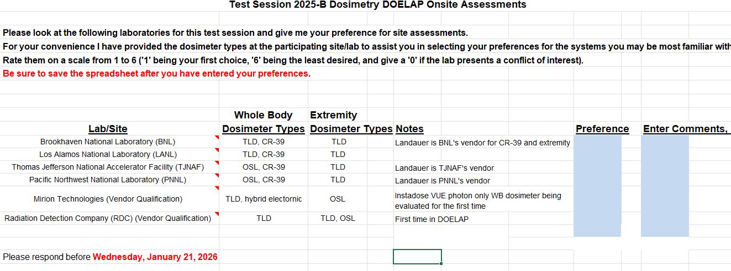
Selection of Assessors
Around the first of the year (B session) and first of March (A session), you’ll get an email soliciting interest and availability

Slide 3
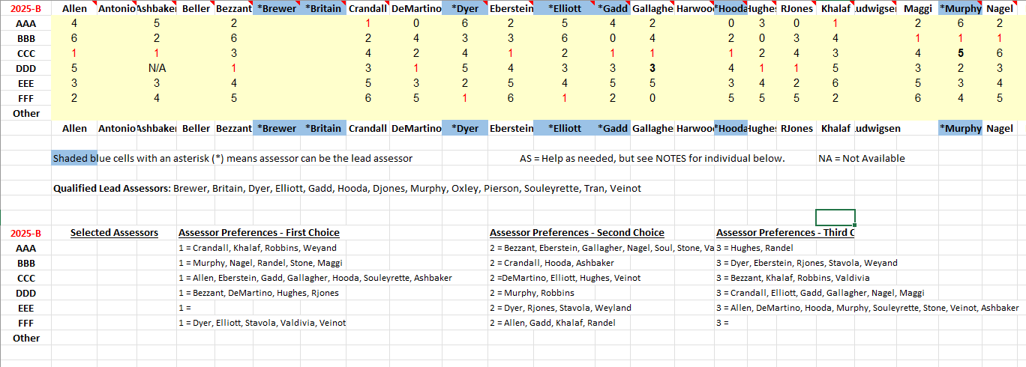
Selection of Assessors
B session assessments are typically done ~mid-March to April
A session assessments are typically done ~mid-May to mid-July
No later than ~3rd week of July
Must complete 3 assessments prior to being assigned Team Lead

Slide 4
Prepare for the Assessment
Good planning maximizes the effectiveness of the assessment
Planning is critical to the success of the assessment
Communication between assessment team members and the program to be assessed enhances both successful planning and eliminates the element of surprise
The STM will provide a link for the assessment materials.
Discussion on document sharing/availability

Slide 5
Assessment Team Lead Duties
Team Lead works with site to arrange:
  Lodging
  Map
  Security Clearances
  Site resources (computers, printers, staging room)
  Scheduling opening meeting
    Interested Management
    Site staff (radiobioassay, dosimetry, quality assurance)
    DOE Field/Area Office representative
  Discusses preliminary findings with other assessors after initial review of documents.
  May draft preliminary report before assessment.
    Incomplete or non-compliant items.

Slide 6
Assessment Materials
Site DOELAP application
Quality Assurance Plan (QAP) submitted with the application
  the QAP is also available from the link in question 11 on the application
Performance Testing results for the Test Session
  Results may be from the previous test session, e.g. Landauer tests in 26-A, the site applies in 26-B
Previous onsite assessment in PDF and Word file formats
  the Word file is converted (with errors) from the PDF file… use with caution

Slide 7
Assessment Materials
corrective action plan from the previous onsite assessment
  Vendor CAP?
a packet of assessor files that will be helpful for the onsite assessment
  Next slide will list the files
additional documents or messages that may be pertinent to the site being assessed or to the implementation of the DOELAP standards

Slide 8
Assessment Files
https://resl.id.energy.gov/assessordata/dosimetry/Audit%20Sites/HanfordMIS/HanfordMIS.html

Slide 9
AI Assistance for Assessment Preparation?
Applicant site and assessor site cyber/information security policies
  Approved platforms, information type,
Strategies
  Key word/phrase searching
  Narrowing down areas to focus on
  Organizing notes or report
Importance of the human element
  Use AI as a starting point, follow up in real life
  Verify anything AI tells you
  Review anything AI creates for accuracy/relevance
  Use AI as a tool, assessors are fundamentally responsible

Slide 10
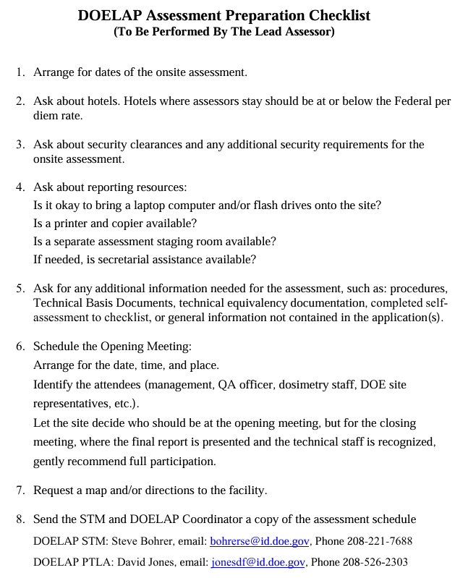
Assessment Checklist

Slide 11
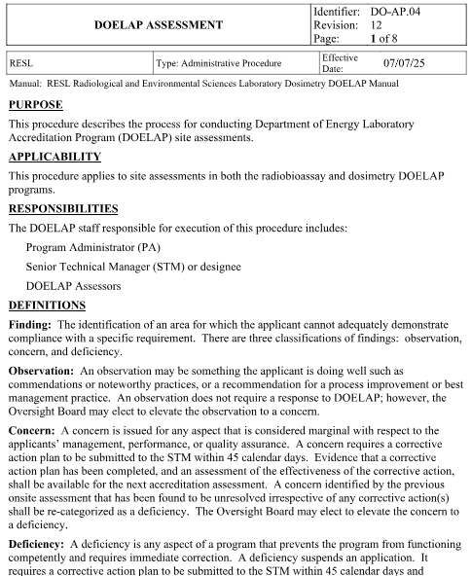
DOELAP Assessment procedure

Slide 12
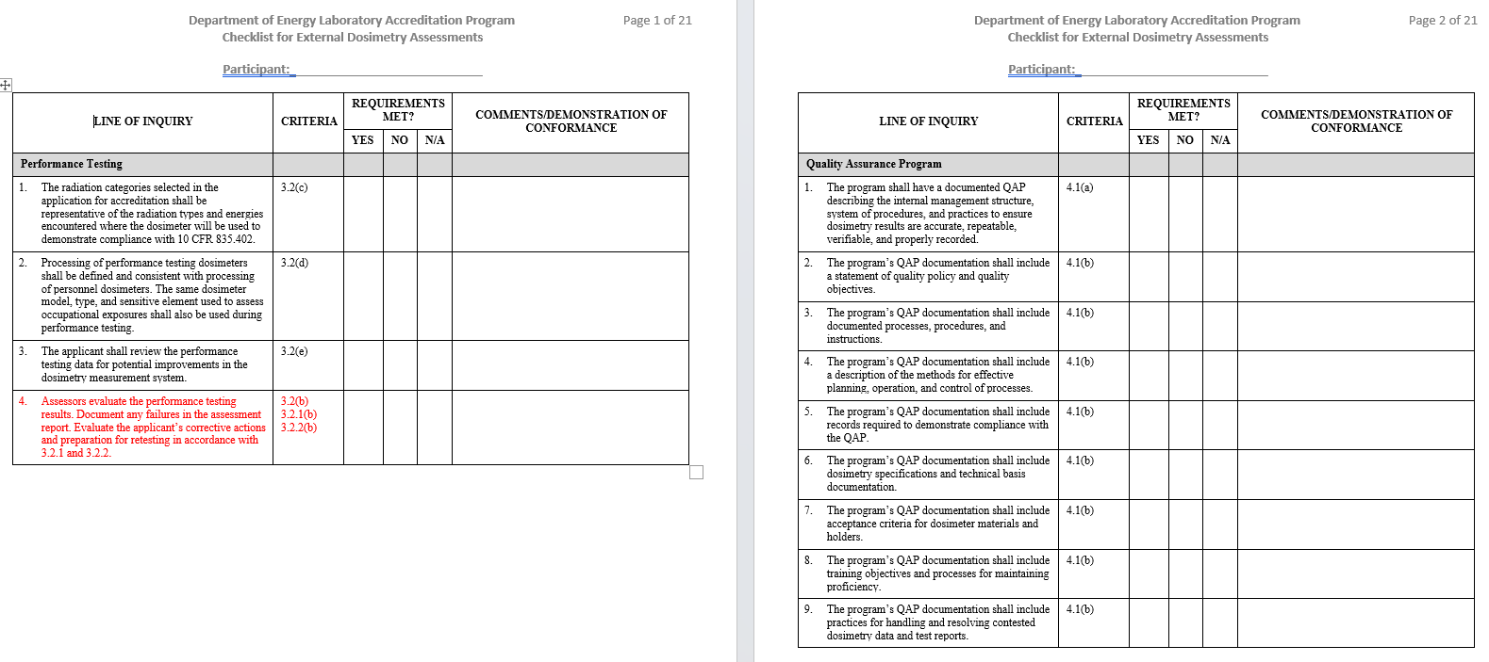
Assessment Checklist

Slide 13
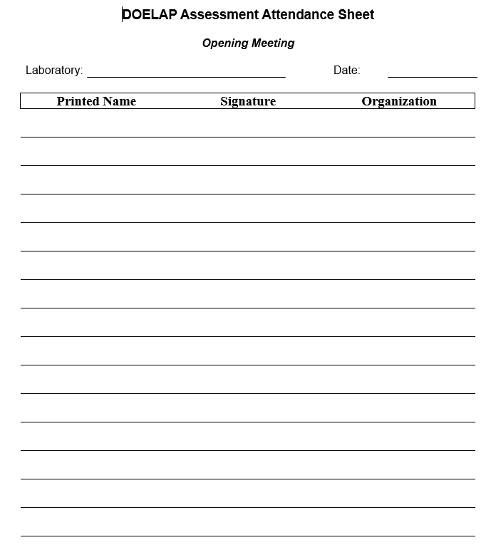
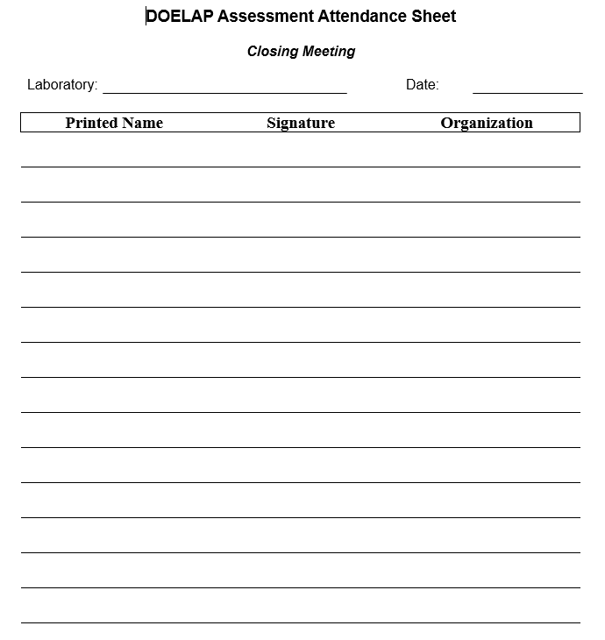
Meeting Attendance Sheets

Slide 14
Assessment Report
Previous Assessment Report
Blank Assessment Report
If using the previous assessment report make sure to change the name in the instructions to the field office. The field office should forward the Site’s response with a cover letter indicating concurrence to:
Steve Bohrer, Senior Technical Manager for DOELAP
Radiological and Environmental Sciences Laboratory
U.S. Department of Energy, Idaho Operations Office
1955 Fremont Ave., MS 2112
Idaho Falls, Idaho 83415-2112
bohrerse@id.doe.gov
Change the name from Guy Backstrom

Slide 15
DOELAP Questionnaires
Found at RESL external website:
  https://resl.id.energy.gov/doelap/doelap.html
Dosimetry Performance Test Questionnaire
Radiobioassay Performance Test Questionnaire
Program Assessment Questionnaire
Assessor Evaluation
Encourage sites to provide feedback to DOELAP through the questionnaires

Slide 16
Questions?

